Slide 1
Front-End Web Development Using React (Client Side Technologies - JavaScript)
Front-End Web Development Using React – JS
Eng. Reem Hassan Ahmed

Slide 2
01
Introduction to JavaScript
Front-End Web Development Using React – CSS

Slide 3
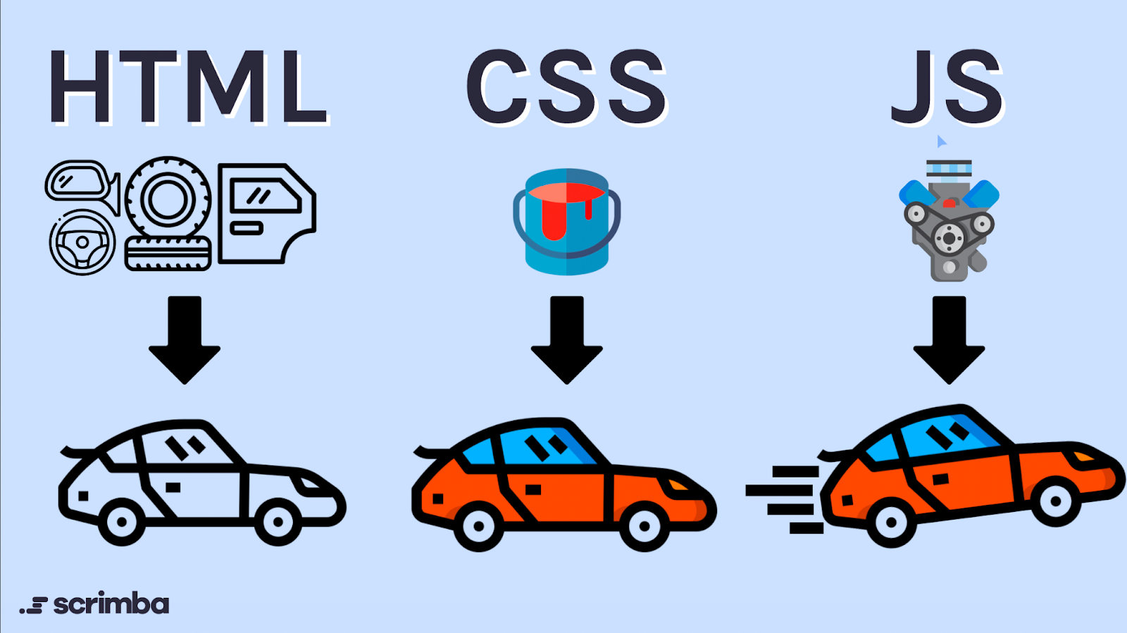
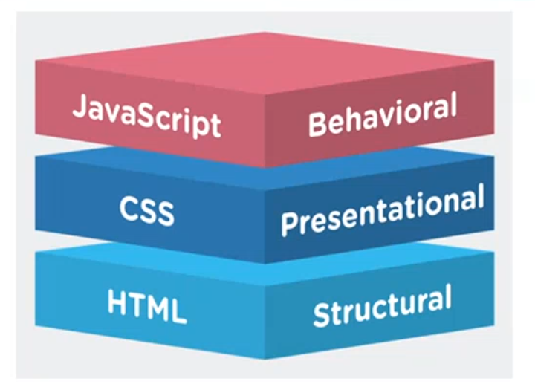
Introduction to JavaScript
JavaScript: Scripting language commonly used to create interactive effects within web browsers.
While HTML is the structure of the web page and CSS is the presentation of that structure, JavaScript is what makes that structure dynamic.
JavaScript is an object-oriented language.

Slide 4
Introduction to JavaScript Cont.
Difference between scripting language and programming language:
Scripting Language | Programming Language
Interpreted | Compiled
Doesn’t generate exe file | Generates exe file
Runs after every line interpreting | Runs once

Slide 5
Introduction to JavaScript Cont.
JavaScript characteristics:
Case sensitive
Object-oriented
Interpreted-language
Event driven
Platform-independent (doesn’t depend on the platform like linux, windous, …etc).

Slide 6
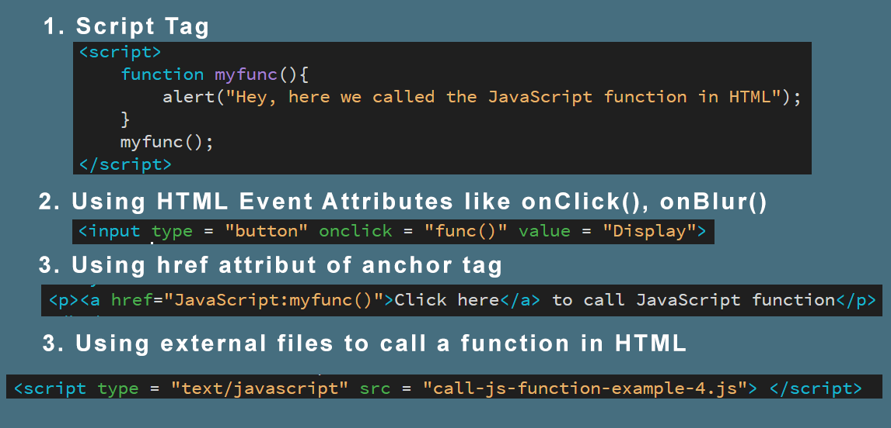
Where to embed JS in code

Slide 7

JavaScript variables
Syntax:
Variable definitions should always start with the keyword var
JavaScript engine figures out the type of a particular variable at runtime.
No types are declared in JavaScript.
JavaScript is called a dynamically (loosely) typed language.
The same variable can hold different types during the life
of the execution of the program.

Slide 8
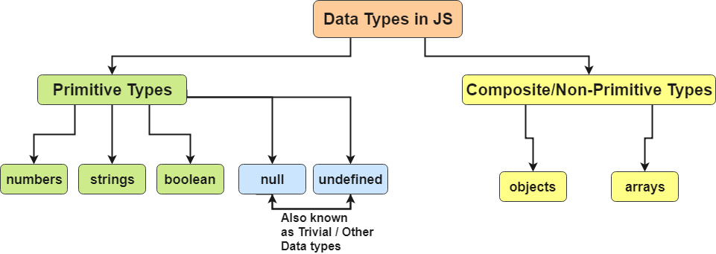
JavaScript Datatypes

Slide 9
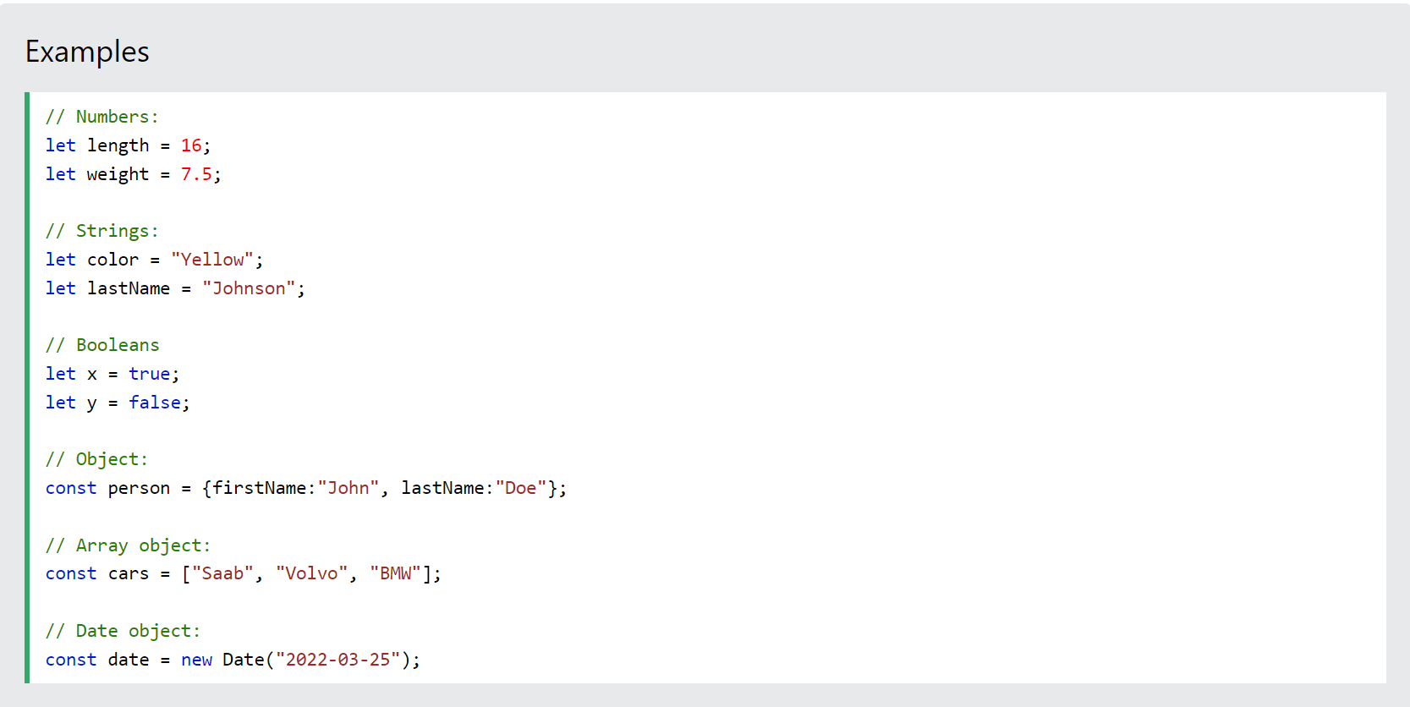
JavaScript Datatypes

Slide 10
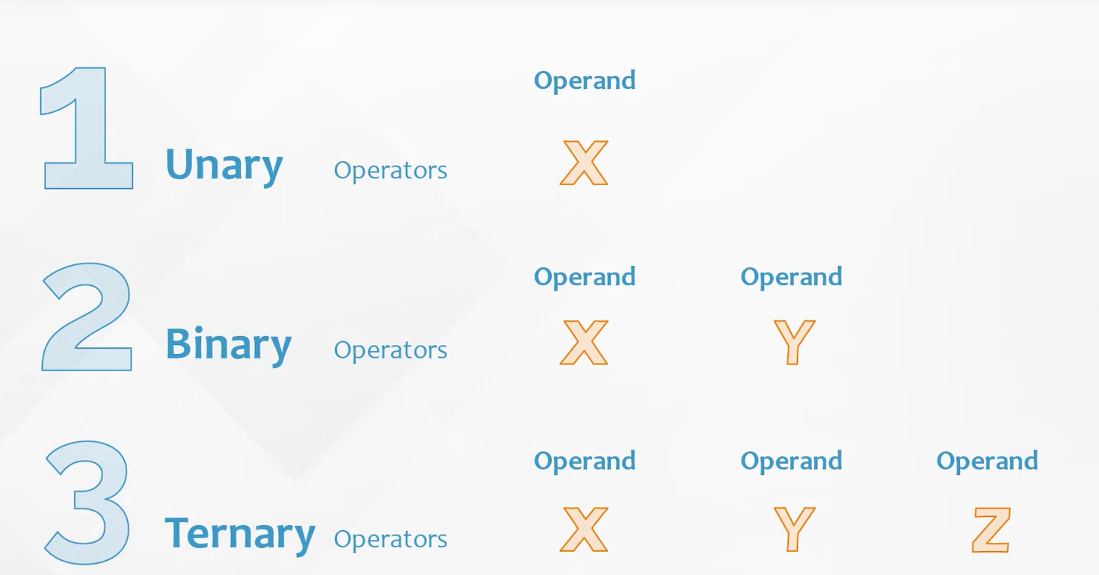
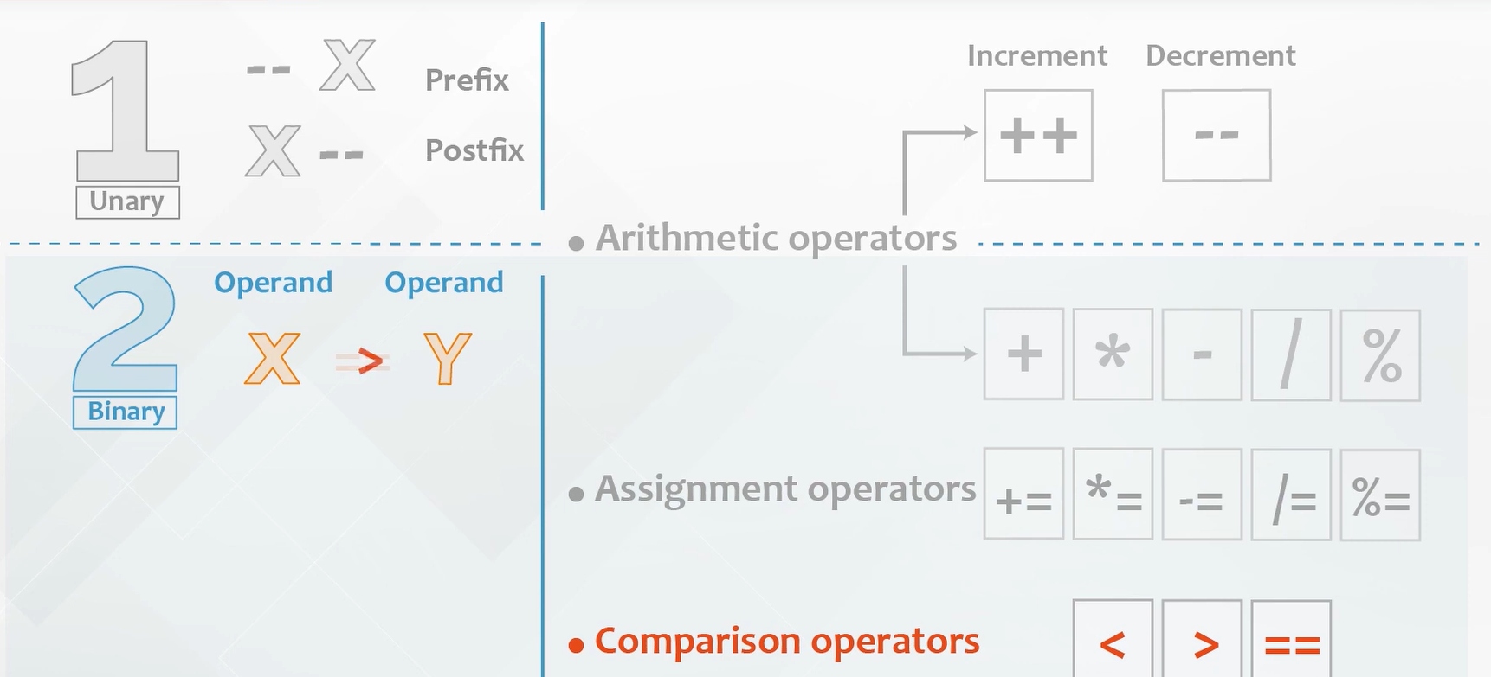
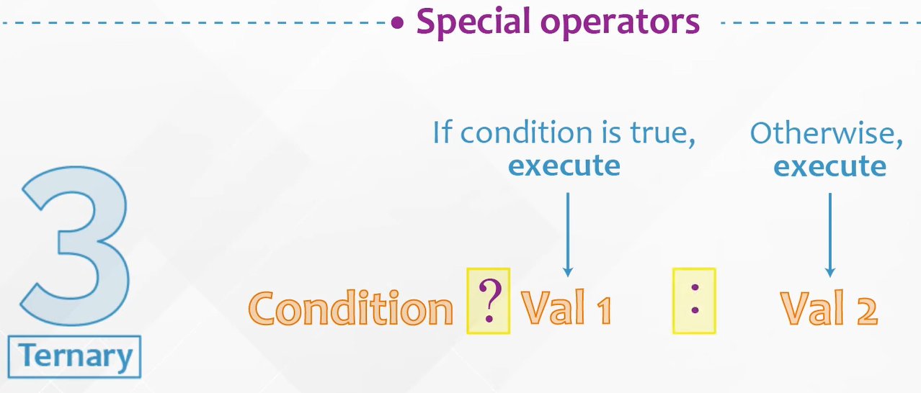
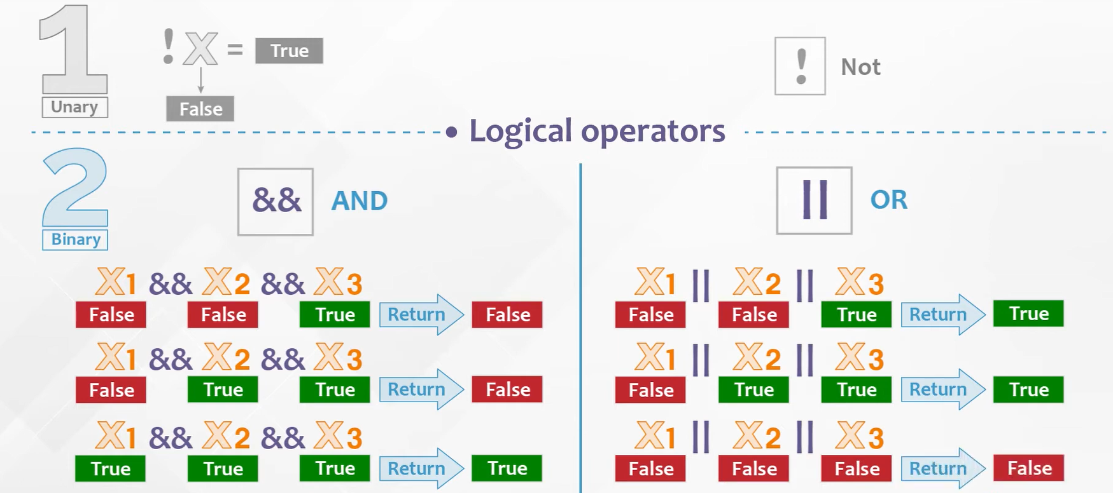
JavaScript Operators
Operators types:

Slide 11
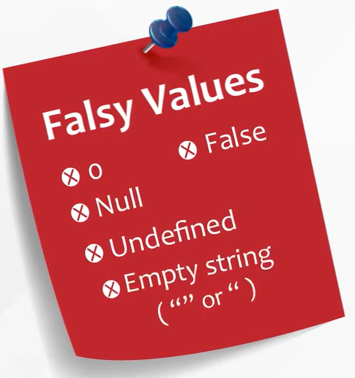
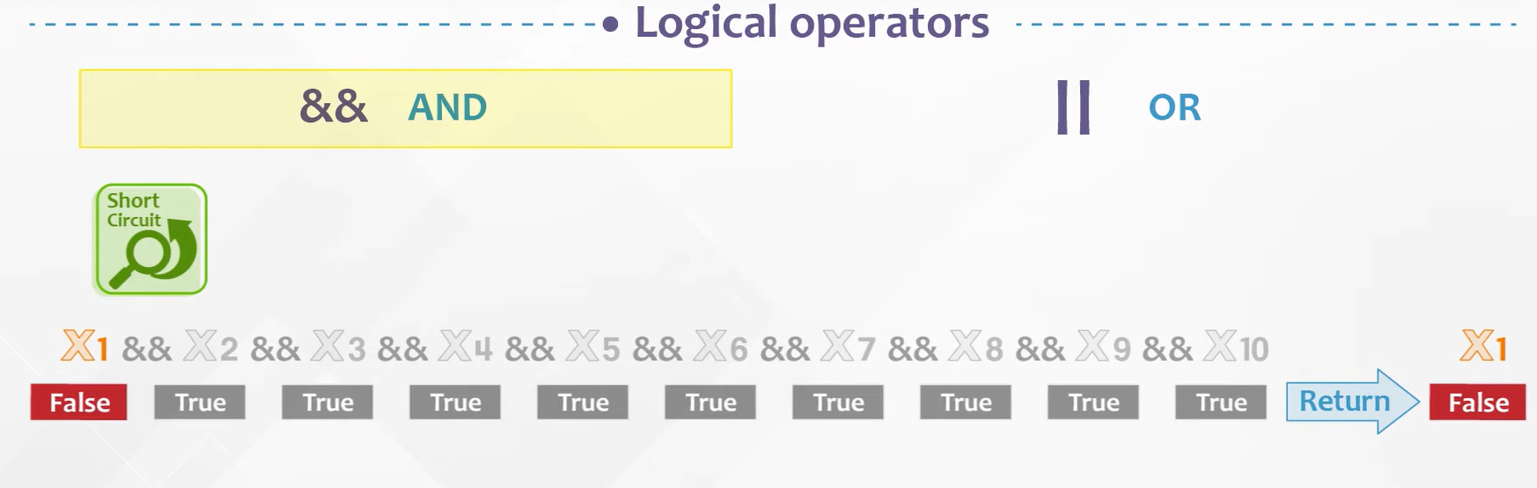
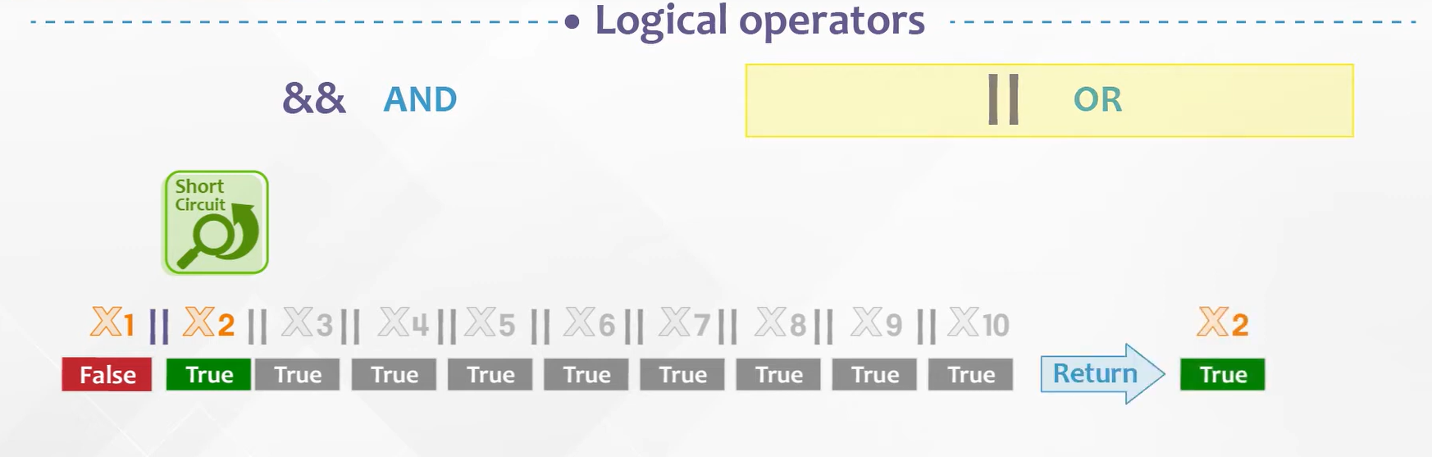
JavaScript Operators
Operators types:

Slide 12
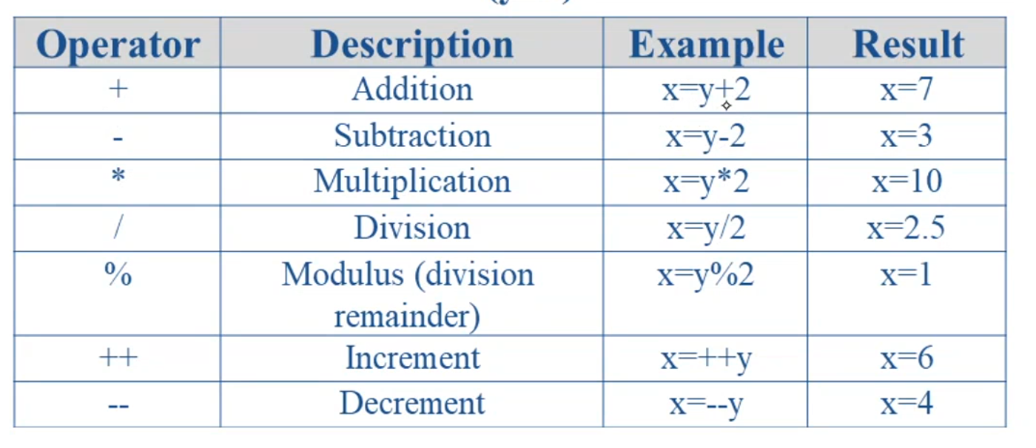
JavaScript Operators
Arithmetic operators:

Slide 13
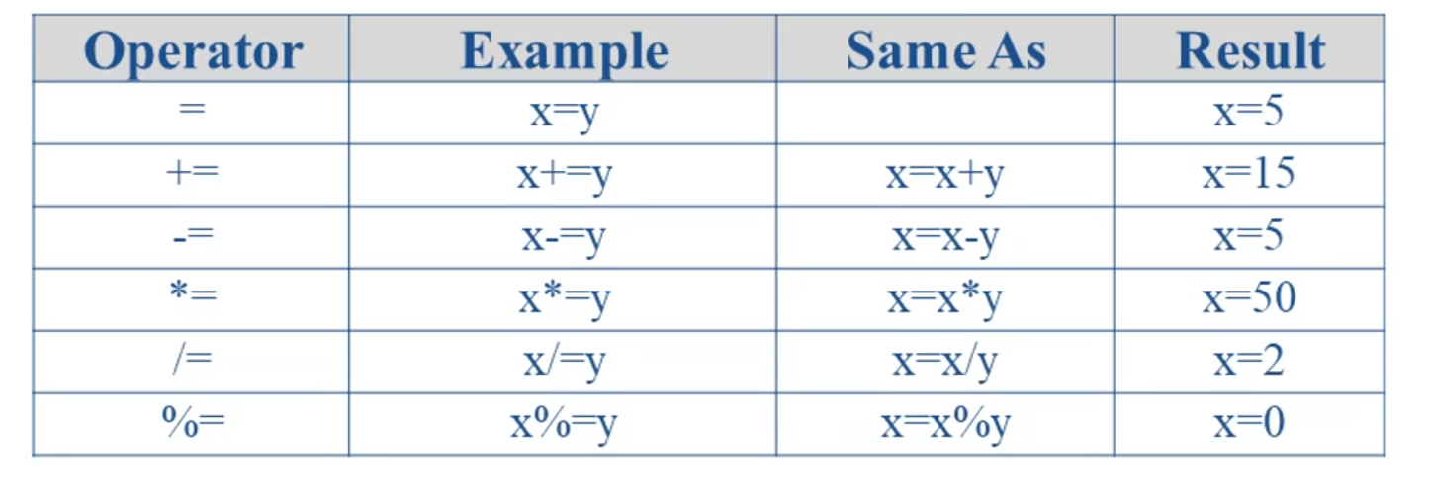
JavaScript Operators
Assignment operators:

Slide 14
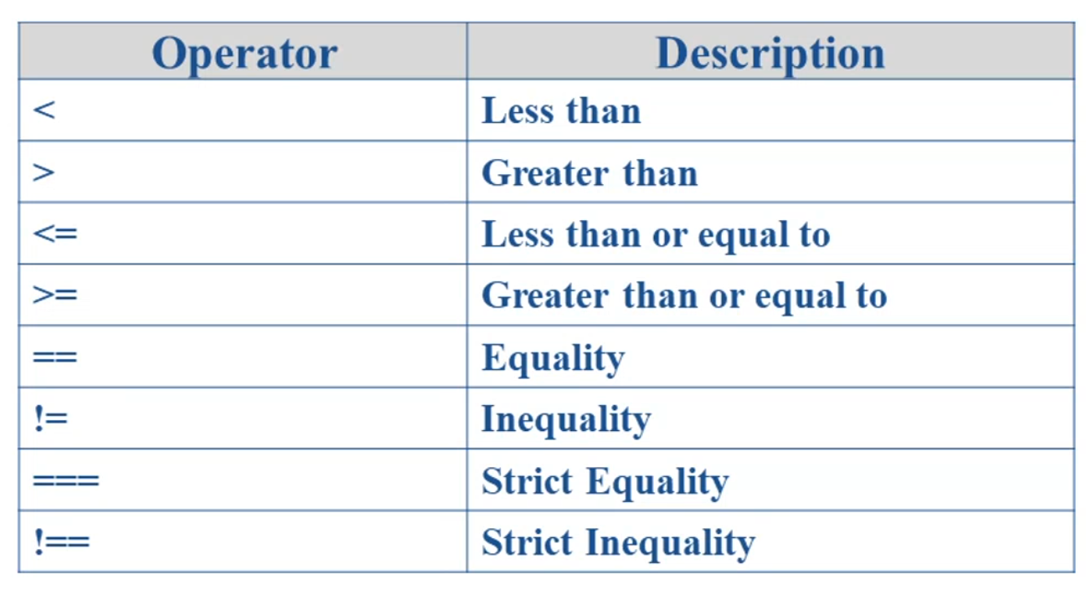
JavaScript Operators
Comparison operators:

Slide 15
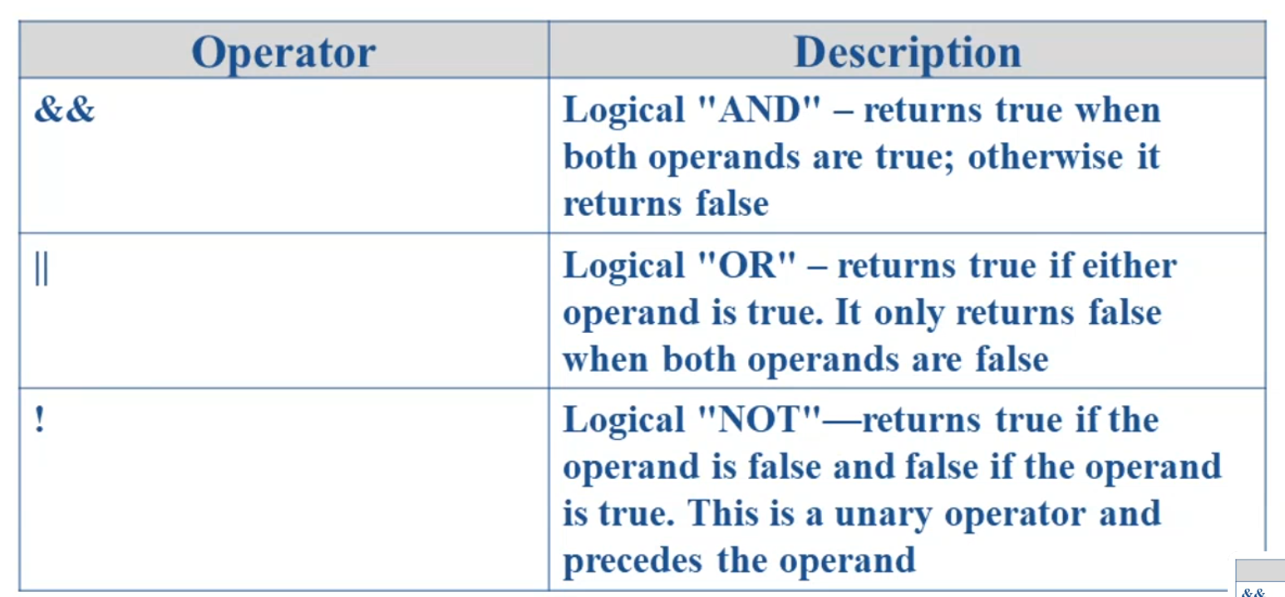
JavaScript Operators
Logical operators:

Slide 16
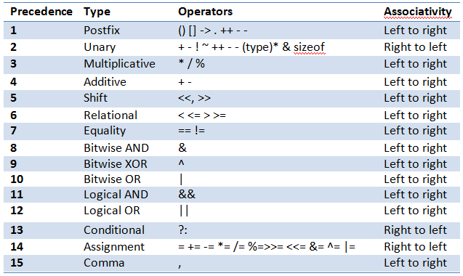
JavaScript Operators
Operators precedence:

Slide 17
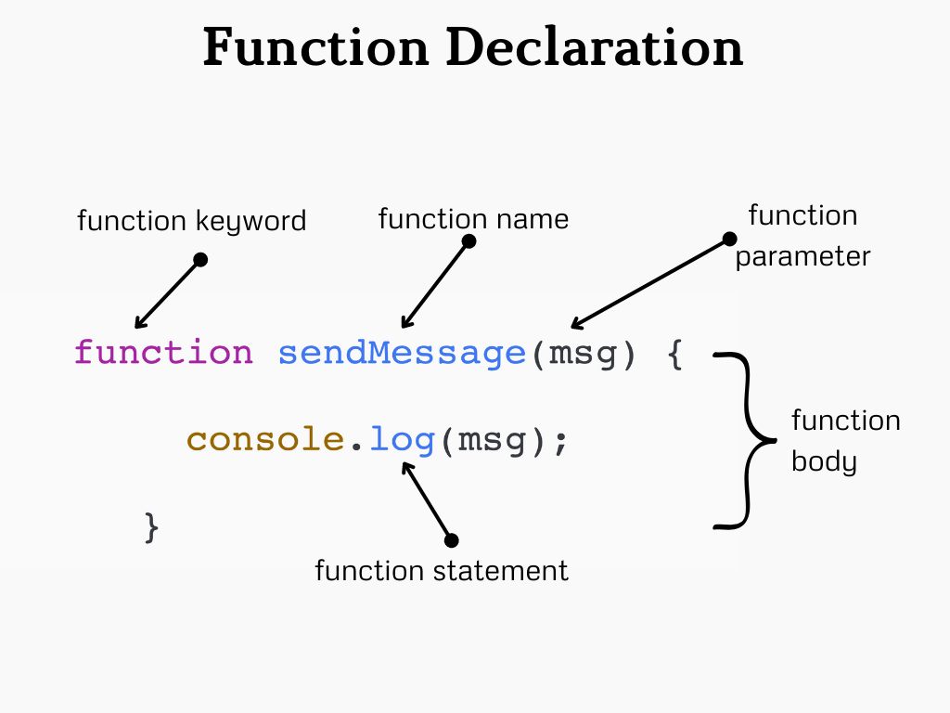
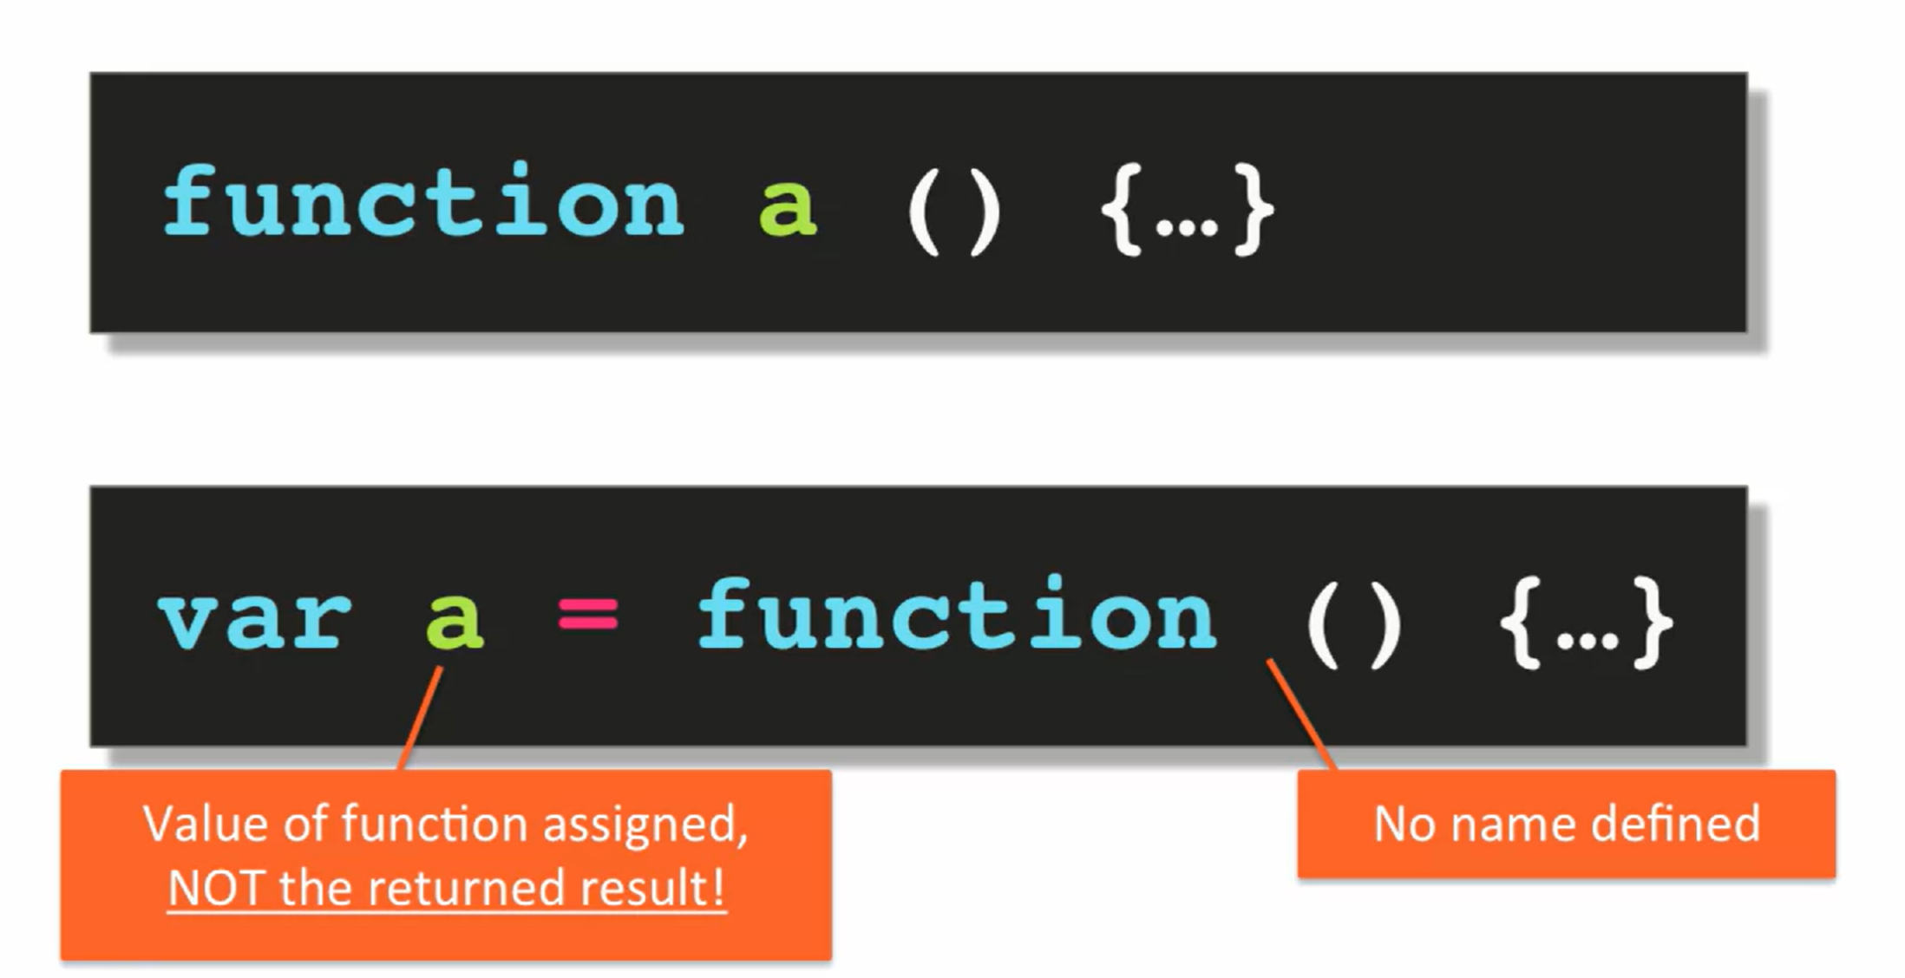
JavaScript Function

Slide 18
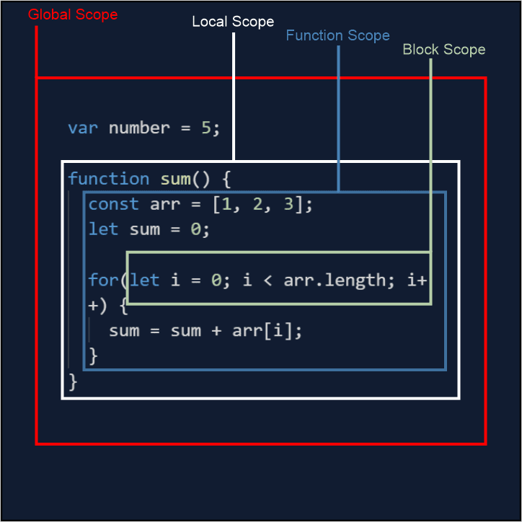
JavaScript Scope

Slide 19
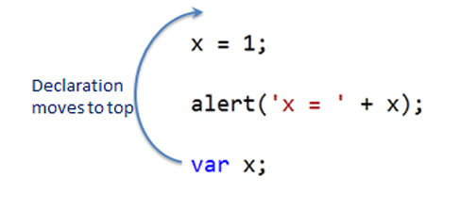
JavaScript Hoisting

Slide 20
02
Controlling program flow
Front-End Web Development Using React – CSS

Slide 21
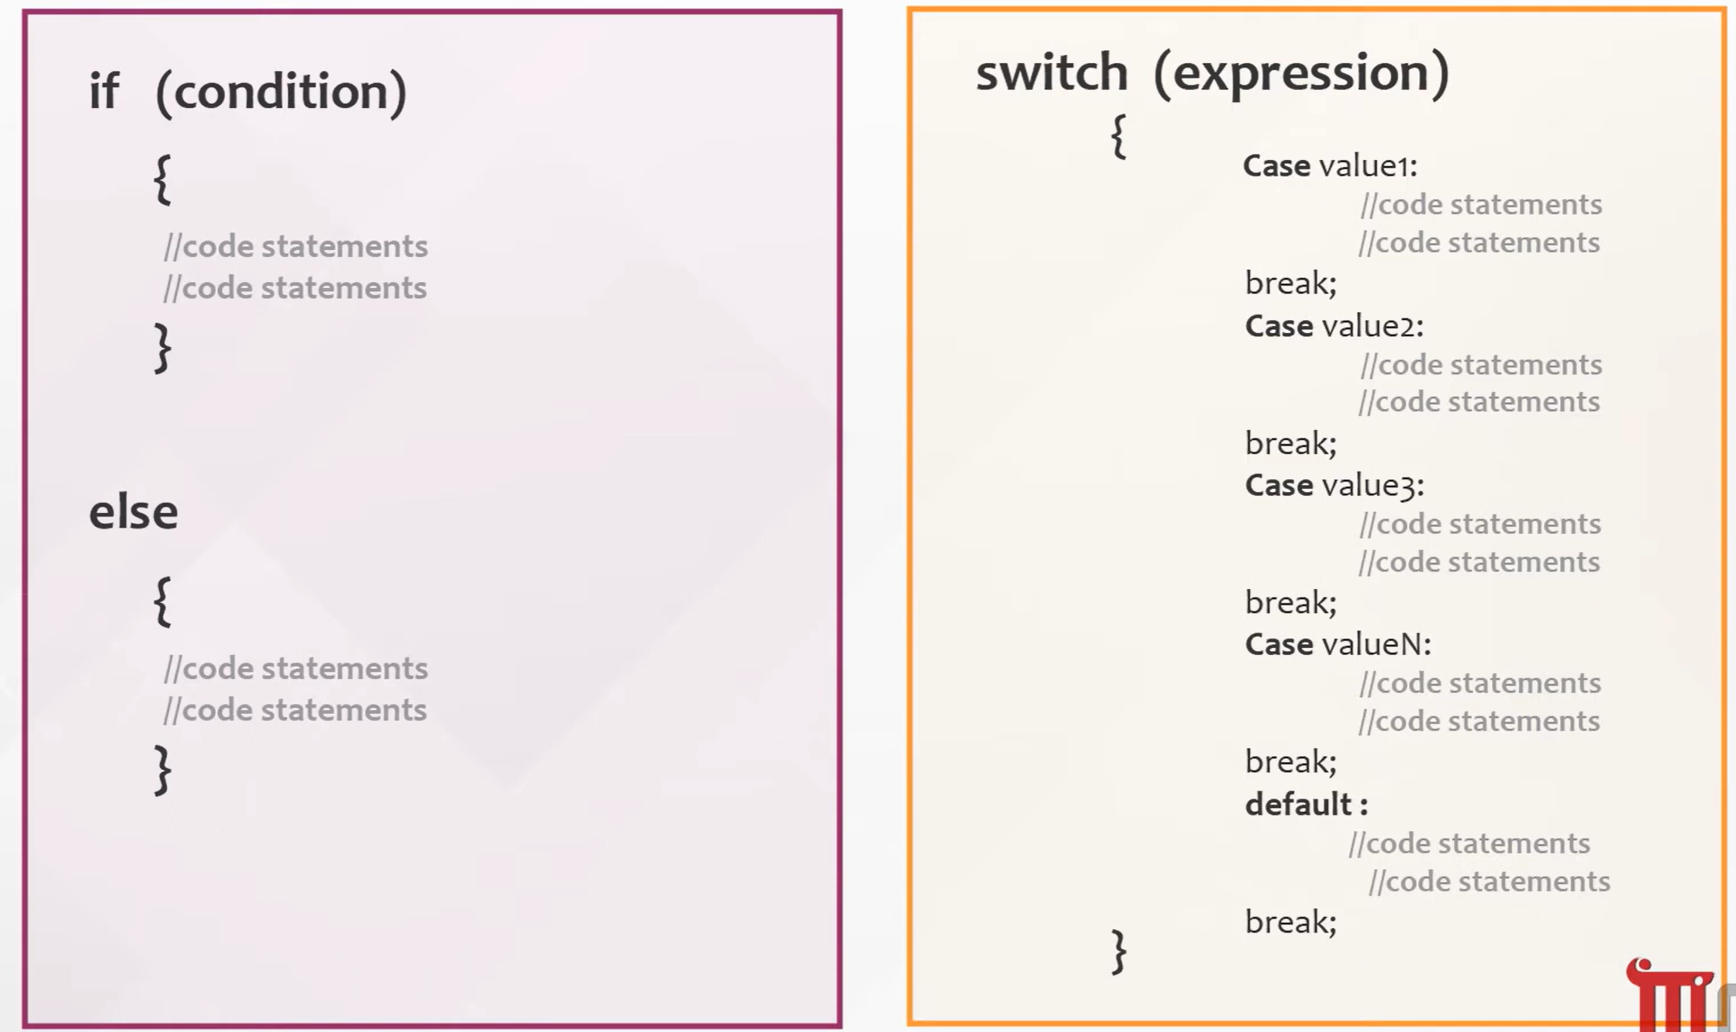
Conditional statement
If statements and Switch-case statements:

Slide 22
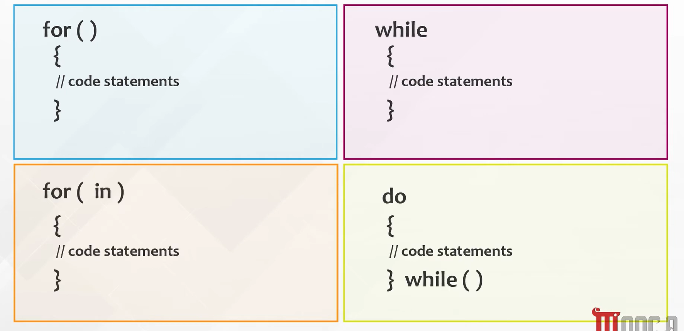
Conditional statement Cont.
Loop statements:

Slide 23
03
Communicate with user
Front-End Web Development Using React – JS

Slide 24
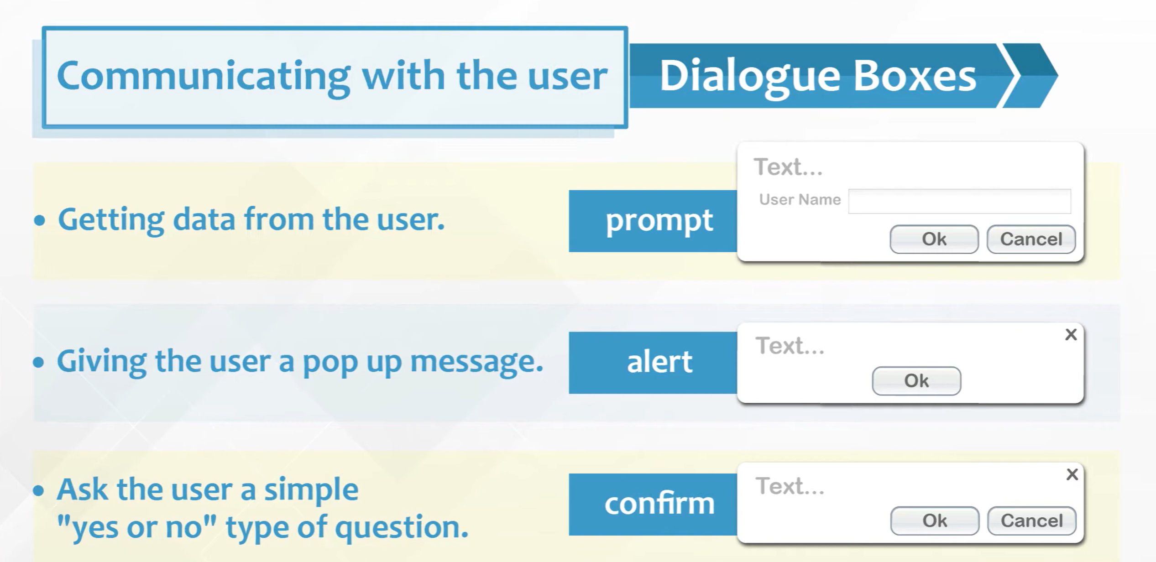
Dialogue boxes

Slide 25
Thanks!
Front-End Web Development Using React – CSS
Does anyone have any question?
ReemHassan160299@gmail.com
+201092427577
Please keep this slide for attribution

